Slide 1
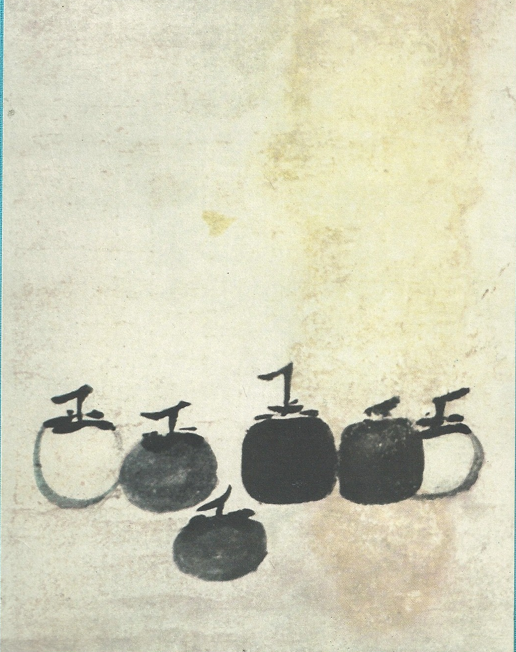
Six Canons of Chinese Painting
Six Persimmons
Mu Qi
13th Century, Song Dynasty
Ink on Paper, 36.2 cm cm × 38.1 cm cm (14.25 in in × 15 in in)

Slide 2
The order of Xie He canons indicate the primary, secondary, and tertiary concerns of Chinese painters.
Based on his Six Canons, Xie He believes that the artist’s primary objective is to capture the vital spirit of the subjects in their paintings as well as to demonstrate their own sensitivity to that spirit.
The second concern in the Six Canons is the artist’s brush work. The artist must handle the brush with expertise and carefully choose the placement of their ink strokes.
The third concern mentioned in the sixth canon is about a standard Chinese practice among painters: copying.
Like artists from many other different cultures, Chinese painters would often copy the works of their masters to learn and further develop their painting skills, as well as to form their own ideas on painting.

Slide 3
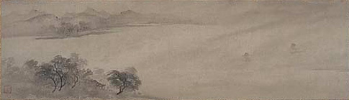
The Six principles of Chinese painting were established by Xie He(Hsieh Ho), a writer, art historian and critic in 6th century China.
He is most famous for his "Six points to consider when judging a painting" (繪畫六法, Pinyin: Huìhuà Liùfǎ), taken from the preface to his book "The Record of the Classification of Old Painters" (古畫品錄; Pinyin: Gǔhuà Pǐnlù).
This was written circa 550 and refers to "old" and "ancient" practices.
Returning Sails off Distant Shore, Attributed to Mu qi

Slide 4
The six elements that define a painting are:
"Spirit Resonance," or vitality, Chi seems to translate to the nervous energy transmitted from the artist into the work. The overall energy of a work of art. Xie He said that without Spirit Resonance, there was no need to look further.
"Bone Method," or the way of using the brush. This refers not only to texture and brush stroke, but to the close link between handwriting and personality. In his day, the art of calligraphy was inseparable from painting.
"Correspondence to the Object," or the depicting of form, which would include shape and line.
"Suitability to Type," or the application of color, including layers, value and tone.
"Division and Planning," or placing and arrangement, corresponding to composition, space and depth.
"Transmission by Copying," or the copying of models, not only from life but also the works of antiquity.

Slide 5
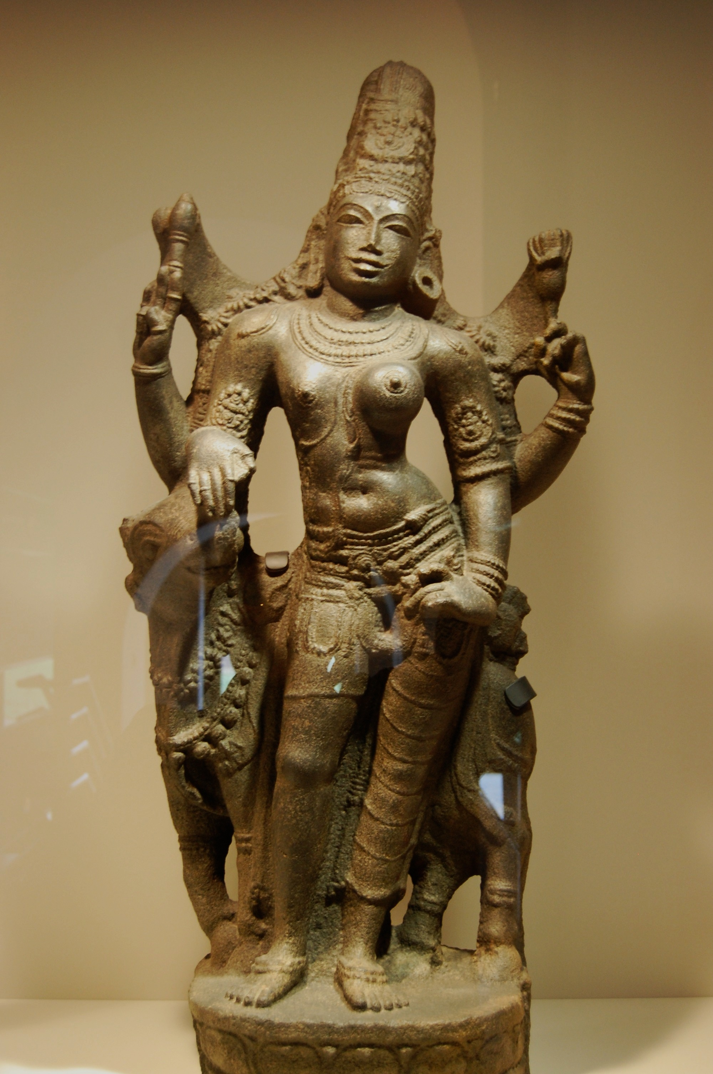
Six Limbs of Indian Art

Slide 6
Sadanga of Indian painting
Around the 1st century BC the Sadanga or Six Limbs of Indian Painting, were evolved, a series of canons laying down the main principles of the art. Vatsyayana, who lived during the third century A.D., enumerates these in his Kamasutra having extracted them from still more ancient works.
These 'Six Limbs' have been translated as follows:
Rupabheda The knowledge of appearances.
Pramanam Correct perception, measure and structure.
Bhava Action of feelings on forms.
Lavanya Yojanam Infusion of grace, artistic representation.
Sadrisyam Similitude.
Varnikabhanga Artistic manner of using the brush and colours.
The subsequent development of painting by the Buddhists indicates that these ' Six Limbs ' were put into practice by Indian artists, and are the basic principles on which their art was founded.

Slide 7
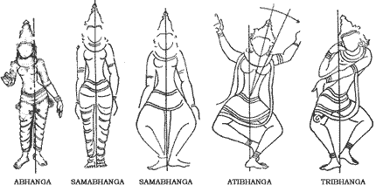

Slide 8
Bharata Muni enunciated the eight Rasas in the Nātyasāstra:
Śṛngāram (शृङ्गारं) Love, Attractiveness. Presiding deity: Vishnu. Colour:green.
Hāsyam (हास्यं) Laughter, Mirth, Comedy. Presiding deity: Ganesha. Colour: white.
Raudram (रौद्रं) Fury. Presiding deity: Rudra. Colour: red.
Kāruṇyam (कारुण्यं) Compassion, Tragedy. Presiding deity: Yama. Colour:dove coloured.
Bībhatsam (बीभत्सं) Disgust, Aversion. Presiding deity: Shiva. Colour: blue
Bhayānakam (भयानकं) Horror, Terror. Presiding deity: Kala. Colour: black
Vīram (वीरं) Heroic mood. Presiding deity: Indra. Colour:wheatish brown
Adbhutam (अद्भुतं) Wonder, Amazement. Presiding deity: Brahma. Colour: yellow

Slide 9
Navarasa
As the tradition of alankara-shastra developed from the sixth through tenth centuries CE, a ninth rasa was contentiously endorsed by certain scholars; this rasa was only widely accepted after an extended philosophical and aesthetic theorization by Abhinavagupta. Subsequently, the nine rasas were accepted by the majority of the Alankarikas, and the expression Navarasa (the nine rasas), could come into vogue.
Śāntam Peace or tranquility. deity: Vishnu. Colour: white
In addition to the nine Rasas, two more appeared later (esp. in literature): Additional rasas:
Vātsalya (वात्सल्य) Parental Love
Bhakti (भक्ति) Spiritual Devotion

Slide 10
Bhavas
The Natyasastra identifies eight rasas with eight corresponding Bhava (mood):
Rati (Love)
Hasya (Mirth)
Soka (Sorrow)
Krodha (Anger)
Utsaha (Energy)
Bhaya (Terror)
Jugupsa (Disgust)
Vismaya (Astonishment)

